Slide 1
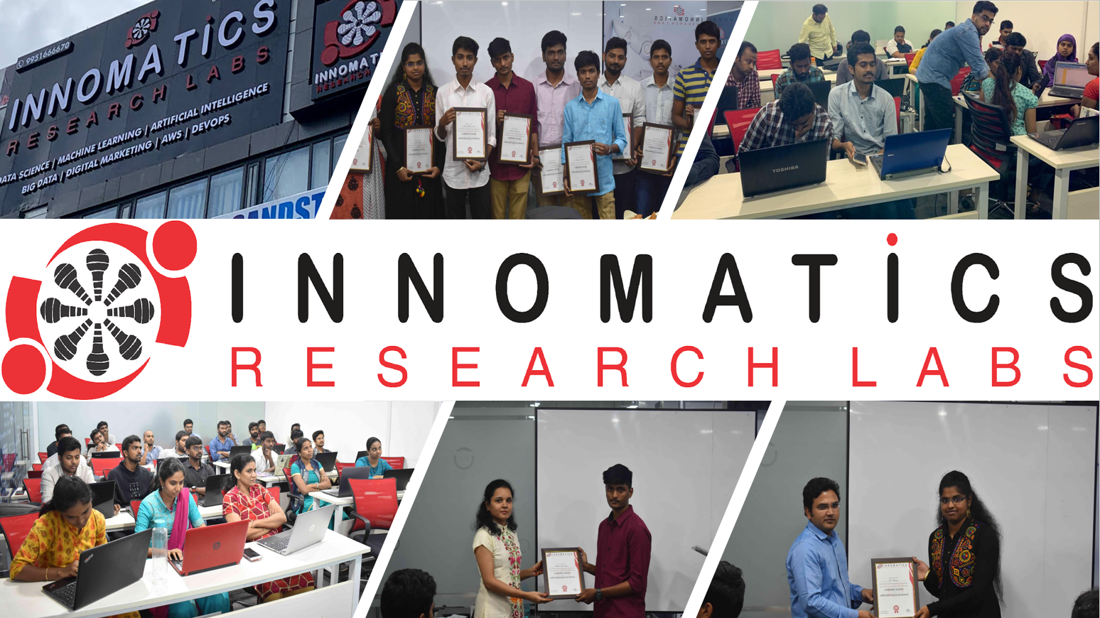

FOR APX SPORTS
2021
1/16

Slide 2


OUR PERSONALIZED MUSIC RECOMANDATION SYSTEM
Music is Everything

Slide 3
ABOUT US
We are the team of Graduate and Post Graduate engineering students, who are willing to kickstart their career in IT related fields.
It was a great opportunity for all of us to be a part of Innomatics Research Labs. The way Kanav Bansal sir taught was too simple to understand,and very easy to grasp.
Team Members
Gaurav Kumar - B Tech (ME) (2019-2023)
Siddharth Tewani - B Tech (CSE)(2018-2022)
Durga U - M.Sc (Data Science)(2020-2022)
Arpit Jaiswal - B Tech (CSE)(2019-2023)
Duggirala Akhil -B Tech (CSE) (2018-2022)

Slide 4
What is Recommandation System?
Recommendation System
Recommender systems are the systems that are designed to recommend things to the user based on many different factors. These systems predict the most likely product that the users are most likely to purchase and are of interest to. Companies like Netflix, Amazon, etc. use recommender systems to help their users to identify the correct product or movies for them.

Slide 5
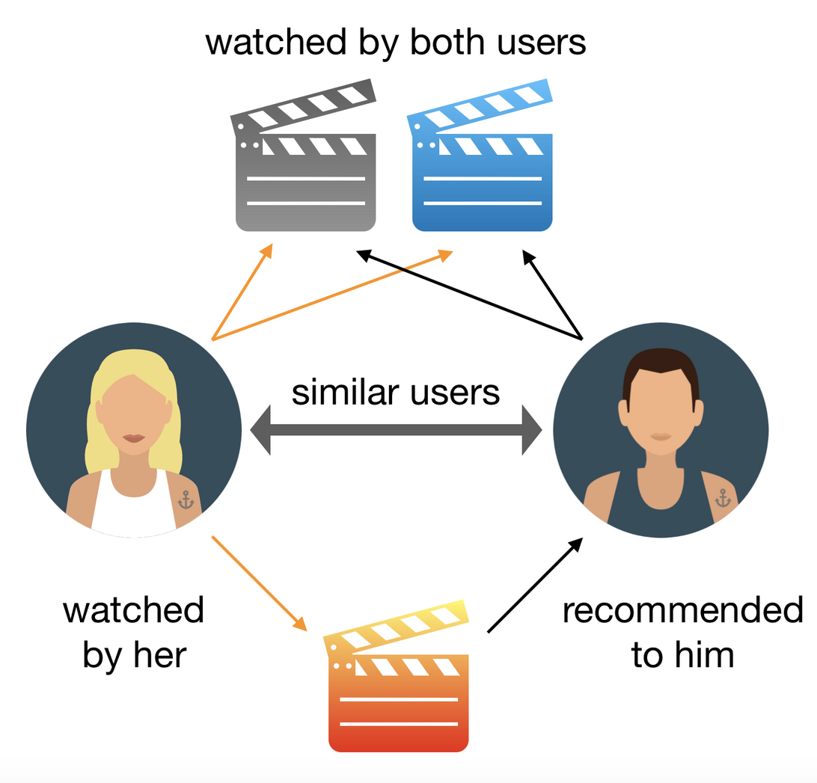
How it basically works.

Slide 6
Popularity Based Filtering
Different Techniques for Recommandation Systems
Popularity based recommendation system works with the trend. It basically uses the items which are in trend right now.
Content Based Filtering
A Content-Based Recommender works by the data that we take from the user, either explicitly (rating) or implicitly (clicking on a link)
Collaborative Based Filtering
Collaborative filtering methods are based on collecting and analyzing a large amount of information on user behaviors, activities or preferences and predicting what users will like based on their similarity to other users.
It is of two types: -
Item-Item similarity method
User-User similarity method

Slide 7

Popularity Based Filtering
As the name suggests Popularity based recommendation system works with the trend. It basically uses the items which are in trend right now. For example, if any product which is usually bought by every new user then there are chances that it may suggest that item to the user who just signed up.

Slide 8
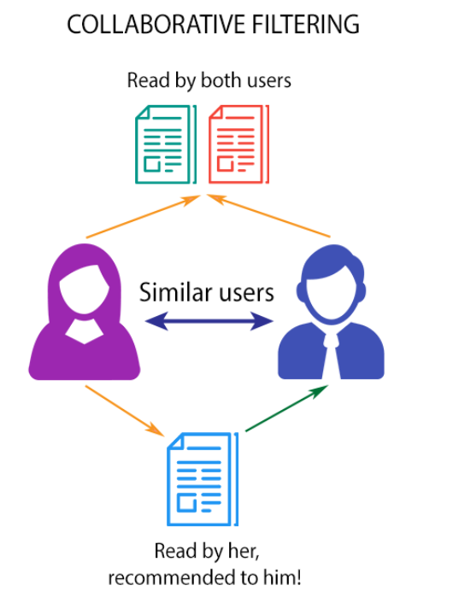
COLLABORATIVE BASED FILTERING
It is done by 2 Methods
By Using Item-Item Similarity
By Using User-User Similarity

Slide 9
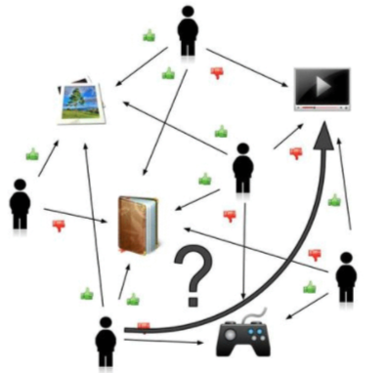
ITEM-ITEM &
USER-USER
FILTERING

Slide 10

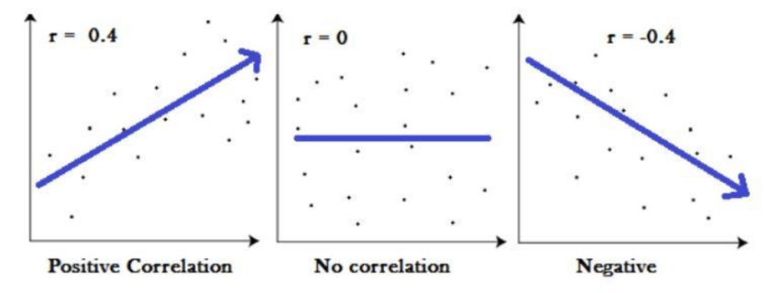

Using Correlation
TYPES OF CORRELATIONS

Slide 11
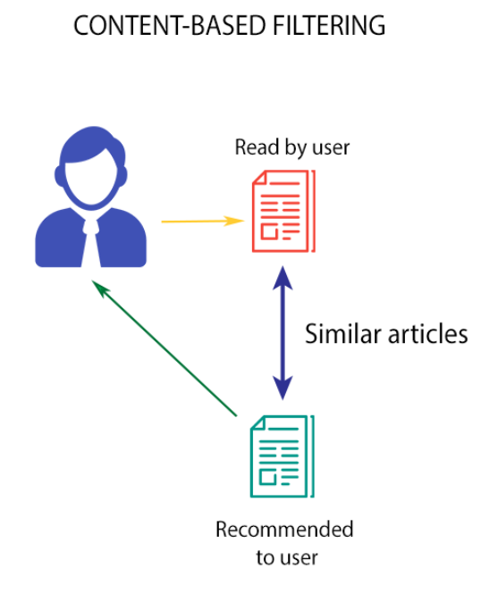
Content Based Filtering
A Content-Based Recommender works by the data that we take from the user, either explicitly or implicitly. By the data we create a user profile, which is then used to suggest to the user, as the user provides more input or take more actions on the recommendation, the engine becomes more accurate.

Slide 12

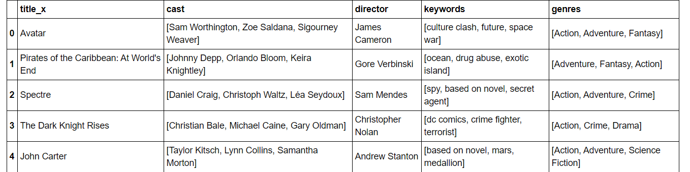
Data required for Content Based Recommandation System

Slide 13

# **Future Scope**
We have applied several filtering techniques for our recommendation system which includes:
* Popularity Based Filtering
* Content based Filtering (not enough RAM)
* Collaborative Based filtering
- Using Correlation
- Using Nearest neighbours
- Using Surprise
But our current recommendation model cannot recommend relevant products to a new user in a personalized manner ,i.e., it suffers from Cold Start Problem.
So to make sure it doesn't happen, it can be prevented by hybrid filtering which is actually a mixture of both content based and collaborative based filtering.
Collaborative filtering using surprise library should further be improved as the RMSE score is 1125.28
We can also try to implement collaborative filtering approach using Turicreate
FUTURE SCOPE
We have applied several filtering techniques for our recommendation system which includes:
* Popularity Based Filtering
* Content based Filtering (not enough RAM)
* Collaborative Based filtering
- Using Correlation
- Using Nearest neighbours
- Using Surprise
But our current recommendation model cannot recommend relevant products to a new user in a personalized manner ,i.e., it suffers from Cold Start Problem.
So to make sure it doesn't happen, it can be prevented by hybrid filtering which is actually a mixture of both content based and collaborative based filtering.
Collaborative filtering using surprise library should further be improved as the RMSE score is 1125.28
We can also try to implement collaborative filtering approach using Turicreate

Slide 14
Conclusion
It is better to have a combination of different approaches for a recommender systems having popularity based, content based and collaborative based filtering as each of the approach has its own drawback hence they can't be applied individually.
Popularity based recommender systems are not personalized at all as they recommend the same songs for all kind of users.
Content based recommender systems require high computational power as compared to collaborative filtering.

Slide 15

T H A N K Y O U

